Slide 1
Module 3

Slide 2
Module 3: Process Synchronization:
Background,
The Critical Section Problem,
Peterson’s Solution
Synchronization Hardware
Mutex Locks
Semaphores- Usage, Implementation
Deadlock and Starvation
Classical Problems of Synchronization The Reader-Writer Problem
Dining-Philosopher Problem

Slide 3
Introduction of Process Synchronization
Processes can execute concurrently
May be interrupted at any time, partially completing execution
Concurrent access to shared data may result in data inconsistency
Maintaining data consistency requires mechanisms to ensure the orderly execution of cooperating processes
Illustration of the problem:
Suppose that we wanted to provide a solution to the consumer-producer problem that fills all the buffers. We can do so by having an integer counter that keeps track of the number of full buffers. Initially, the counter is set to 0. It is incremented by the producer after it produces a new buffer and is decremented by the consumer after it consumes a buffer.

Slide 4
Producer Code
while (true) { /* produce an item in next produced */
while (counter == BUFFER_SIZE) ;
/* do nothing */
buffer[in] = next_produced;
in = (in + 1) % BUFFER_SIZE;
counter++;
}

Slide 5
Consumer Code
while (true) {
while (counter == 0)
; /* do nothing */
next_consumed = buffer[out];
out = (out + 1) % BUFFER_SIZE;
counter--;
/* consume the item in next consumed */
}

Slide 6
Race Condition
counter++ could be implemented as register1 = counter register1 = register1 + 1 counter = register1
counter-- could be implemented as register2 = counter register2 = register2 - 1 counter = register2
Consider this execution interleaving with “count = 5” initially:
S0: producer execute register1 = counter {register1 = 5} S1: producer execute register1 = register1 + 1 {register1 = 6} S2: consumer execute register2 = counter {register2 = 5} S3: consumer execute register2 = register2 – 1 {register2 = 4} S4: producer execute counter = register1 {counter = 6 } S5: consumer execute counter = register2 {counter = 4}

Slide 7
Critical Section
Consider system of n processes {p₀, p₁, … p_{n-1}}
Each process has critical section segment of code
Process may be changing common variables, updating table, writing file, etc
When one process in critical section, no other may be in its critical section
Critical section problem is to design protocol to solve this
Each process must ask permission to enter critical section in entry section, may follow critical section with exit section, then remainder section

Slide 8
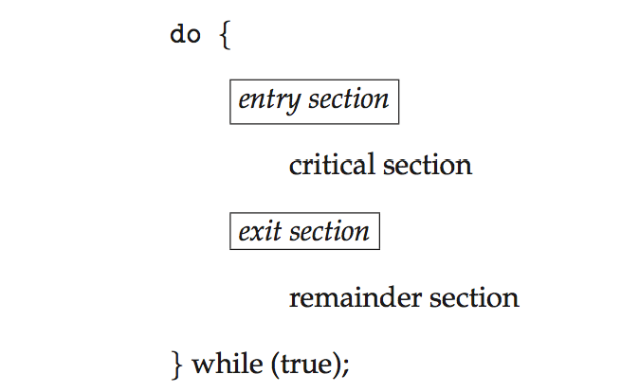
Critical Section

Slide 9
Solution to Critical-Section Problem
Mutual Exclusion - If process Pi is executing in its critical section, then no other processes can be executing in their critical sections
Progress - If no process is executing in its critical section and there exist some processes that wish to enter their critical section, then the selection of the processes that will enter the critical section next cannot be postponed indefinitely
Bounded Waiting - A bound must exist on the number of times that other processes are allowed to enter their critical sections after a process has made a request to enter its critical section and before that request is granted

Slide 10
Peterson’s Solution
Classic software-based solution to the critical section
it provides a good algorithmic description of solving the critical-section problem but no guarantee to work with modern architecture
Two process solution
Restricted to two processes share two variables:
int turn;
Boolean flag[2]
The variable turn indicates whose turn it is to enter the critical section
The flag array is used to indicate if a process is ready to enter the critical section. flag[i] = true implies that process Pi is ready!

Slide 11
Algorithm for Process Pi
do {
flag[i] = true;
turn = j;
while (flag[j] && turn = = j);
critical section
flag[i] = false;
remainder section
} while (true);

Slide 12
Algorithm for Process Pj
do {
flag[j] = true;
turn = i;
while (flag[i] && turn = = i);
critical section
flag[i] = false;
remainder section
} while (true);

Slide 13
Peterson’s Solution
Provable that the three CS requirement are met:
1. Mutual exclusion is preserved
Pi enters CS only if:
either flag[j] = false or turn = i
2. Progress requirement is satisfied
3. Bounded-waiting requirement is met

Slide 14
Disadvantages of the Peterson’s Solution
Waiting for the other processes to exit the critical region may take a long time. We call it busy waiting.
On systems that have multiple CPUs, this algorithm might not function.
The Peterson solution can only run two processes concurrently

Slide 15
Hardware Support for Synchronization
Software-based solutions are not guaranteed to work on modern computer architectures
Many systems provide hardware support for critical section code
Uniprocessors – could disable interrupts
Currently running code would execute without preemption
Generally too inefficient on multiprocessor systems
Operating systems using this not broadly scalable
Modern machines provide special atomic hardware instructions
Atomic = non-interruptable
Either test memory word and set value
Or swap contents of two memory words

Slide 16
TestAndSet(lock) algorithm
A hardware solution for synchronization problems.
There is a shared lock variable, which may have a 0(Unlocked) or 1(Locked) value.
Before entering the critical section process enquires about the lock.
If it is locked it keeps on waiting till it becomes free.
If it is unlocked the process takes the lock and executes the critical section.
boolean test and set(boolean *target) {
boolean rv = *target;
*target = true;
return rv;
}

Slide 17
TestAndSet(lock) algorithm
Here, the shared variable is lock which is initialized to false.
do { while (test_and_set(&lock))
; /* do nothing */
/* critical section */
lock = false;
/* remainder section */
} while (true);

Slide 18
TestAndSet(lock) algorithm
It always returns whatever value is sent to it and sets lock to true.
The first process will enter the critical section at once as TestAndSet(lock) will return false and it’ll break out of the while loop. The other processes cannot enter now as lock is set to true and so the while loop continues to be true. Mutual exclusion is ensured.
Once the first process gets out of the critical section, lock is changed to false. So, now the other processes can enter one by one. Progress is also ensured.
However, after the first process, any process can go in. There is no queue maintained, so any new process that finds the lock to be false again can enter. So bounded waiting is not ensured.

Slide 19
Mutex lock
The hardware-based solutions to the critical-section problem presented are complicated as well as generally inaccessible to application programmers.
Instead, operating-system designers build higher-level software tools to solve the critical section problem.
The simplest of these tools is the mutex lock. (In fact, the term mutex is short for mutual exclusion.)
Usually implemented via hardware atomic instructions
But this solution requires busy waiting; this lock, therefore, called a spinlock

Slide 20
Mutex lock
By using the mutex lock critical sections are protected and thus race conditions is prevented.
A process must acquire the lock before entering a critical section; It releases the lock when it exits the critical section.
The acquire()function acquires the lock, and the release() function releases the lock
A mutex lock has a boolean variable available whose value indicates if the lock is available or not. If the lock is available, a call to acquire() succeeds, and the lock is then considered unavailable. Process that attempts to acquire an unavailable lock is blocked until the lock is released.

Slide 21
Solution to the critical-section problem using mutex locks
while (true) {
acquire lock
critical section
release lock
remainder section
}
acquire() {
while (!available)
; /* busy wait */
available = false;
}
release() {
available = true;
}
Calls to either acquire() or release() must be performed atomically

Slide 22
Semaphore in Operating Systems (OS)
The Semaphore is just a normal integer. Can only be accessed via two indivisible (atomic) operations
The Semaphore cannot be negative. The least value for a Semaphore is zero (0). The Maximum value of a Semaphore can be anything.
The Semaphores usually have two operations.
The two operations have the capability to decide the values of the semaphores.
The two Semaphore Operations are:
Wait ( )
Signal ( )

Slide 23
Wait Semaphore Operation
The Wait Operation is used for deciding the condition for the process to enter the critical state or wait for the execution of the process.
Originally called P()
P (Semaphore value)
{
Allow the process to enter if the value of Semaphore is greater than zero or positive.
Do not allow the process if the value of Semaphore is less than zero or zero.
Decrement the Semaphore value if the Process leaves the Critical State.
}
Definition of the wait() operation
wait(S) {
while (S <= 0)
; // busy wait
S--;
}

Slide 24
Signal Semaphore Operation
The Signal Semaphore Operation is used to update the value of Semaphore. The Semaphore value is updated when the new processes are ready to enter the Critical Section.
V (Semaphore value)
{
If the process goes out of the critical section then add 1 to the semaphore value
Else keep calm until process exits
}
Definition of the signal() operation
signal(S) {
S++;
}

Slide 25
Semaphore Usage
1. Binary Semaphore
Here, there are only two values of Semaphore in Binary Semaphore Concept. The two values are 1 and 0.
If the Value of Binary Semaphore is 1, then the process has the capability to enter the critical section area. If the value of Binary Semaphore is 0 then the process does not have the capability to enter the critical section area.
2. Counting Semaphore
Here, there are two sets of values of Semaphore in Counting Semaphore Concept. The two types of values are values greater than and equal to one and other type is value equal to zero.
If the Value of Binary Semaphore is greater than or equal to 1, then the process has the capability to enter the critical section area. If the value of Binary Semaphore is 0 then the process does not have the capability to enter the critical section area.

Slide 26
To implement semaphores under this definition, we define a semaphore as follows:
typedef struct {
int value;
struct process *list;
} semaphore;
Each semaphore has an integer value and a list of processes list.
wait(semaphore *S) {
S->value--;
if (S->value < 0) {
add this process to S->list;
sleep();
}
}
When a process must wait on a semaphore, it is added to the list of processes.

Slide 27
To implement semaphores under this definition, we define a semaphore as follows:
signal(semaphore *S) {
S->value++;
if (S->value <= 0) {
remove a process P from S->list;
wakeup(P);
}
}
A signal() operation removes one process from the list of waiting processes and awakens that process.

Slide 28
Observations
Must guarantee that no two processes can execute the wait() and signal() on the same semaphore at the same time
Thus, the implementation becomes the critical section problem where the wait and signal code is placed in the critical section
Could now have busy waiting in critical section implementation
But the implementation code is short Little busy waiting if the critical section is rarely occupied
Note that applications may spend lots of time in critical sections and therefore this is not a good solution

Slide 29
Deadlock and Starvation
The implementation of a semaphore with a waiting queue may result in a situation where two or more processes are waiting indefinitely for an event that can be caused only by one of the waiting processes.
The event in question is the execution of a signal() operation. When such a state is reached, these processes are said to be deadlocked.
P0
wait(S);
wait(Q);
. .
. .
. .
signal(S);
signal(Q);
P1
wait(S);
wait(Q);
. .
. .
. .
signal(S);
signal(Q);
Starvation – indefinite blocking (A process may never be removed from the semaphore queue in which it is suspended)

Slide 30
Classic Problems of Synchronization
In this section, we present a number of synchronization problems as examples of a large class of concurrency-control problems.
These problems are used for testing nearly every newly proposed synchronization scheme.
In our solutions to the problems, we use semaphores for synchronization, since that is the traditional way to present such solutions. However, actual implementations
of these solutions could use mutex locks in place of binary semaphores.

Slide 31
The Readers–Writers Problem
A database is to be shared among several concurrent processes.
Some of these processes may want only to read the database, whereas others may want to update (that is, read and write) the database.
These two types of processes are distinguished by referring to the former as readers and to the latter as writers.
Obviously, if two readers access the shared data simultaneously, no adverse effects will result.
However, if a writer and some other process (either a reader or a writer) access the database simultaneously, chaos may ensue.
To ensure that these difficulties do not arise, we require that the writers have exclusive access to the shared database while writing to the database

Slide 32
Solution to reader–writer problem
The mutex semaphore is used to ensure mutual exclusion when the variable readcount is updated. The readcount variable keeps track of how many processes are currently reading the object.
The semaphore rw_mutex functions as a mutual exclusion semaphore for the writers as well as the first or last reader that enters or exits the critical section.

Slide 33
Writer Process
while (true) {
wait(mutex);
readcount++;
if (readcount == 1)
wait(rw_mutex);
signal(mutex);
. . .
/* reading is performed */
. . .
wait(mutex);
read count--;
if (readcount == 0)
signal(rw mutex);
signal(mutex);
}
while (true) {
wait(rw_mutex);
. . .
/* writing is performed */
. . .
signal(rw_mutex);
}
Reader Process
the reader processes share the following data structures:
semaphore rw mutex = 1;
semaphore mutex = 1;
int read count = 0;

Slide 34
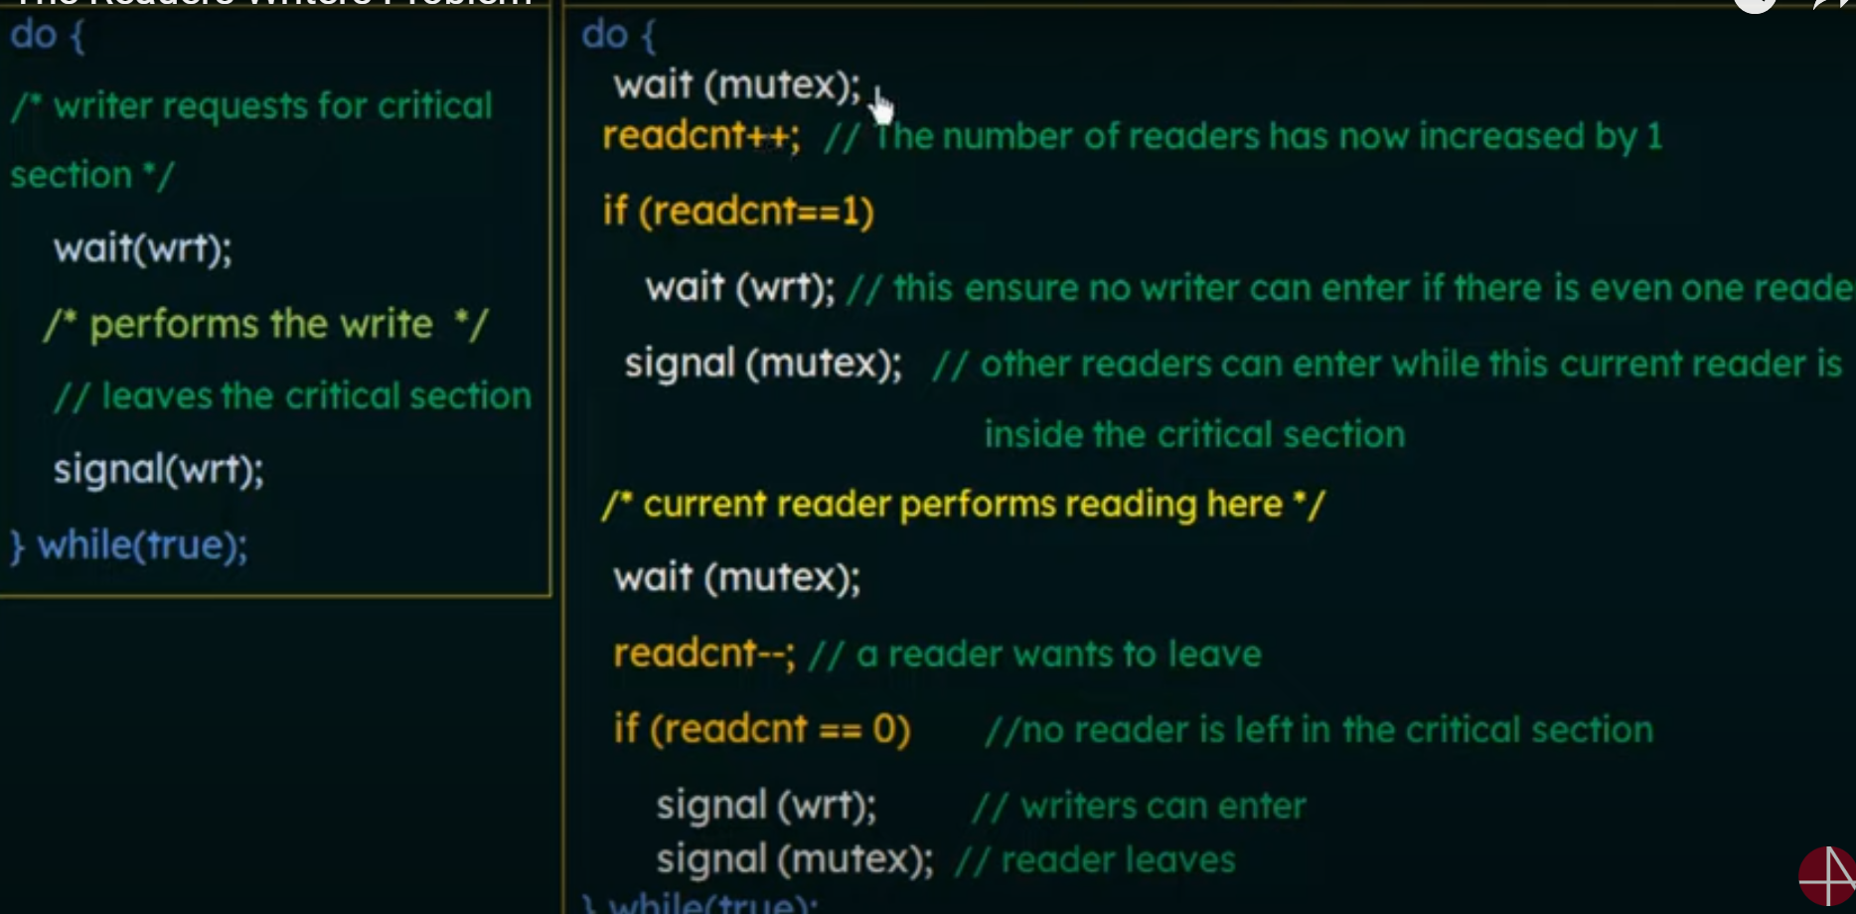

Slide 35
Solution to readers–writers problem
Note that, if a writer is in the critical section and n readers are waiting, then one reader is queued on rw_mutex, and n − 1 readers are queued on mutex.
Also observe that, when a writer executes signal(rw_mutex), we may resume the execution of either the waiting readers or a single waiting writer. The selection is made by the scheduler.

Slide 36
The Dining-Philosophers Problem
Consider five philosophers who spend their lives thinking and eating.
The philosophers share a circular table surrounded by five chairs, each belonging to one philosopher.
In the center of the table is a bowl of rice, and the table is laid with five single chopsticks.

Slide 37
The Dining-Philosophers Problem
When a philosopher thinks, she does not interact with her colleagues.
From time to time, a philosopher gets hungry and tries to pick up the two chopsticks that are closest to her (the chopsticks that are between her and her left and right neighbors).
A philosopher may pick up only one chopstick at a time. Obviously, she cannot pick up a chopstick that is already in the hand of a neighbor.
When a hungry philosopher has both her chopsticks at the same time, she eats without releasing the chopsticks. When she is finished eating, she puts down both chopsticks and starts thinking again.

Slide 38
Structure Of Dining Philosopher Program
while (true) {
wait(chopstick[i]);
wait(chopstick[(i+1) % 5]);
. . .
/* eat for a while */
. . .
signal(chopstick[i]);
signal(chopstick[(i+1) % 5]);
. . .
/* think for awhile */
. . .
}

Slide 39
Deadlocks
System Model
Deadlock Characterization
Necessary Conditions
Resource-Allocation Graph
Methods for Handling
Deadlocks Prevention
Avoidance
Detection and Recovery

Slide 40
System Model
System consists of
Resource types R1, R2, . . ., Rm
CPU cycles, memory space, I/O devices
Each resource type Ri has Wi instances.
Each process utilizes a resource as follows:
Request. The thread requests the resource. If the request cannot be granted immediately (for example, if a mutex lock is currently held by another thread), then the requesting thread must wait until it can acquire the resource.
Use. The thread can operate on the resource (for example, if the resource is a mutex lock, the thread can access its critical section).
Release. The thread releases the resource.

Slide 41
Necessary Conditions.
Deadlock can arise if four conditions hold simultaneously
Mutual exclusion: only one process at a time can use a resource
Hold and wait: a process holding at least one resource is waiting to acquire additional resources held by other processes
No preemption: a resource can be released only voluntarily by the process holding it, after that process has completed its task
Circular wait: there exists a set {P0, P1, …, Pn} of waiting processes such that P0 is waiting for a resource that is held by P1, P1 is waiting for a resource that is held by P2, …, Pn–1 is waiting for a resource that is held by Pn, and Pn is waiting for a resource that is held by P0.

Slide 42
Resource-Allocation Graph
Deadlocks can be described more precisely in terms of a directed graph called a system resource-allocation graph.
A set of vertices V and a set of edges E.
V is partitioned into two types:
P = {P₁, P₂, …, P_{n}}, the set consisting of all the processes in the system
R = {R₁, R₂, …, R_{m}}, the set consisting of all resource types in the system
request edge – directed edge P_{i} → R_{j}
assignment edge – directed edge R_{j} → P_{i}

Slide 43
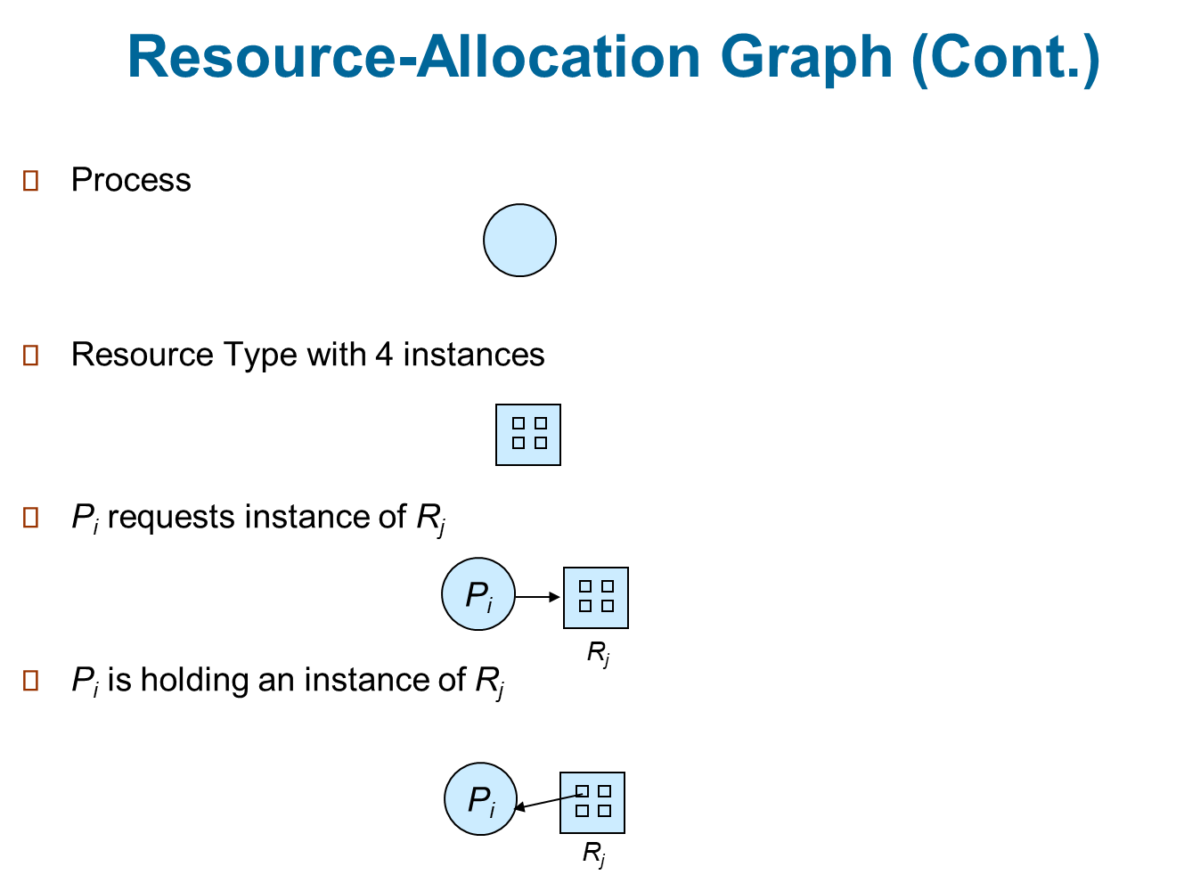
Resource-Allocation Graph

Slide 44
Example of a Resource Allocation Graph
E = {T1 → R1, T2 → R3, R1 → T2, R2 → T2, R2 → T1, R3 → T3}
• Resource instances:
◦ One instance of resource type R1
◦ Two instances of resource type R2
◦ One instance of resource type R3
◦ Three instances of resource type R4
• Thread states:
◦ Thread T1 is holding an instance of resource type R2 and is waiting for an instance of resource type R1.
◦ Thread T2 is holding an instance of R1 and an instance of R2 and is waiting for an instance of R3.
◦ Thread T3 is holding an instance of R3.
if the graph contains no cycles, then no thread in the system is deadlocked. If the graph does contain a cycle, then a deadlock may exist.

Slide 45
Resource Allocation Graph
If each resource type has exactly one instance, then a cycle implies that a deadlock has occurred.
If the cycle involves only a set of resource types, each of which has only a single instance, then a deadlock has occurred.
Each thread involved in the cycle is deadlocked.
In this case, a cycle in the graph is both a necessary and a sufficient condition for the existence of deadlock.
If each resource type has several instances, then a cycle does not necessarily imply that a deadlock has occurred.
In this case, a cycle in the graph is a necessary but not a sufficient condition for the existence of deadlock.

Slide 46
Resource-allocation graph with a deadlock.
Suppose that thread T3 requests an instance of resource type R2. Since no resource instance is currently available, we add a request edge T3 → R2 to the graph.
At this point, two minimal cycles exist in the system:
T1 → R1 → T2 → R3 → T3 → R2 → T1
T2 → R3 → T3 → R2 → T2
Threads T1, T2, and T3 are deadlocked.
Thread T2 is waiting for the resource R3, which is held by thread T3. Thread T3 is waiting for either thread T1 or thread T2 to release resource R2.
In addition, thread T1 is waiting for thread T2 to release resource R1

Slide 47
Methods for Handling Deadlocks
Ensure that the system will never enter a deadlock state:
Deadlock prevention
Deadlock avoidence
Allow the system to enter a deadlock state and then recover
Ignore the problem and pretend that deadlocks never occur in the system; used by most operating systems, including UNIX

Slide 48
Deadlock Prevention
Restrain the ways request can be made
Mutual Exclusion – not required for sharable resources (e.g., read-only files); must hold for non-sharable resources
Hold and Wait – must guarantee that whenever a process requests a resource, it does not hold any other resources
Require process to request and be allocated all its resources before it begins execution, or allow process to request resources only when the process has none allocated to it.
Low resource utilization; starvation possible

Slide 49
Deadlock Prevention(Contd….)
No Preemption –
If a process that is holding some resources requests another resource that cannot be immediately allocated to it, then all resources currently being held are released
Preempted resources are added to the list of resources for which the process is waiting
Process will be restarted only when it can regain its old resources, as well as the new ones that it is requesting
Circular Wait – impose a total ordering of all resource types, and require that each process requests resources in an increasing order of enumeration

Slide 50
Deadlock Avoidance
Simplest and most useful model requires that each process declare the maximum number of resources of each type that it may need
The deadlock-avoidance algorithm dynamically examines the resource-allocation state to ensure that there can never be a circular-wait condition
Resource-allocation state is defined by the number of available and allocated resources, and the maximum demands of the processes

Slide 51
Safe State
When a process requests an available resource, system must decide if immediate allocation leaves the system in a safe state
System is in safe state if there exists a sequence <P₁, P₂, …, P_{n}> of ALL the processes in the systems such that for each P_{i}, the resources that P_{i} can still request can be satisfied by currently available resources + resources held by all the P_{j}, with j < I
That is:
If P_{i} resource needs are not immediately available, then P_{i} can wait until all P_{j} have finished
When P_{j} is finished, P_{i} can obtain needed resources, execute, return allocated resources, and terminate
When P_{i} terminates, P_{i +1} can obtain its needed resources, and so on

Slide 52
Banker’s Algorithm(Deadlock avoidance)
1) If Request_{i} <= Need_{i}
Goto step (2) ; otherwise, raise an error condition, since the process has exceeded its maximum claim.
2) If Request_{i} <= Available
Goto step (3); otherwise, P_{i} must wait, since the resources are not available.
3) Have the system pretend to have allocated the requested resources to process P_{i} by modifying the state as
follows:
Available = Available – Request_{i}
Allocation_{i} = Allocation_{i} + Request_{i}
Need_{i} = Need_{i}– Request_{i}

Slide 53
 |  |  |  |  | Total Resourses |  | 10 | 5 | 7
 |  |  |  |  | MAX
Proces | Allocation |  |  | Maximum Need |  |  | Available |  |  | Need
 | A | B | C | A | B | C | A | B | C | A | B | C
P1 | 0 | 1 | 0 | 7 | 5 | 3 | 3 | 3 | 4 | 7 | 4 | 3
P2 | 2 | 0 | 0 | 3 | 2 | 2 |  |  |  | 1 | 2 | 2
P3 | 3 | 0 | 2 | 9 | 0 | 2 |  |  |  | 6 | 0 | 0
P4 | 2 | 1 | 1 | 2 | 2 | 2 |  |  |  | 0 | 1 | 1

Slide 54
Process | Allocation |  |  | Maximum Need |  |  | Available |  |  | Need
 | A | B | C | A | B | C | A | B | C | A | B | C
P1 | 0 | 1 | 0 | 7 | 5 | 3 | 3 | 3 | 4 | 7 | 4 | 3
P2 | 2 | 0 | 0 | 0 | 0 | 0 | 5 | 3 | 4 | 1 | 2 | 2
P3 | 3 | 0 | 2 | 9 | 0 | 2 |  |  |  | 6 | 0 | 0
P4 | 2 | 1 | 1 | 2 | 2 | 2 |  |  |  | 0 | 1 | 1
Process | Allocation |  |  | Maximum Need |  |  | Available |  |  | Need
 | A | B | C | A | B | C | A | B | C | A | B | C
P1 | 0 | 1 | 0 | 7 | 5 | 3 | 3 | 3 | 4 | 7 | 4 | 3
P2 | 2 | 0 | 0 | 0 | 0 | 0 | 5 | 3 | 4 | 0 | 0 | 0 | 1st
P3 | 3 | 0 | 2 | 9 | 0 | 2 | 7 | 4 | 5 | 6 | 0 | 0
P4 | 2 | 1 | 1 | 0 | 0 | 0 |  |  |  | 0 | 0 | 0 | 2nd

Slide 55
Process | Allocation |  |  | Maximum Need |  |  | Available |  |  | Need
 | A | B | C | A | B | C | A | B | C | A | B | C
P1 | 0 | 1 | 0 | 7 | 5 | 3 | 3 | 3 | 4 | 0 | 0 | 0 | 3rd
P2 | 2 | 0 | 0 | 0 | 0 | 0 | 5 | 3 | 4 | 0 | 0 | 0 | 1st
P3 | 3 | 0 | 2 | 9 | 0 | 2 | 7 | 4 | 5 | 0 | 0 | 0 | 4th
P4 | 2 | 1 | 1 | 0 | 0 | 0 | 7 | 5 | 5 | 0 | 0 | 0 | 2nd
 |  |  |  |  |  |  | 10 | 5 | 7
 | Safe Sequence: |  | P2-P4-P1-P3
 | No Deadlock

Slide 56
Example of Banker’s Algorithm
5 processes P₀ through P₄;
3 resource types:
A (10 instances), B (5instances), and C (7 instances)
Snapshot at time T₀:
Allocation Max Available
A B C A B C A B C
P₀ 0 1 0 7 5 3 3 3 2
P₁ 2 0 0 3 2 2
P₂ 3 0 2 9 0 2
P₃ 2 1 1 2 2 2
P₄ 0 0 2 4 3 3

Slide 57
Example (Cont.)
The content of the matrix Need is defined to be Max – Allocation
Need
A B C
P₀ 7 4 3
P₁ 1 2 2
P₂ 6 0 0
P₃ 0 1 1
P₄ 4 3 1
The system is in a safe state since the sequence < P₁, P₃, P₄, P₂, P₀> satisfies safety criteria

Slide 58
Example: P₁ Request (1,0,2)
Check that Request ≤ Available (that is, (1,0,2) ≤ (3,3,2) ⇒ true
Allocation Need Available
A B C A B C A B C
P₀ 0 1 0 7 4 3 2 3 0
P₁ 3 0 2 0 2 0
P₂ 3 0 2 6 0 0
P₃ 2 1 1 0 1 1
P₄ 0 0 2 4 3 1
Executing safety algorithm shows that sequence < P₁, P₃, P₄, P₀, P₂> satisfies safety requirement
Can request for (3,3,0) by P₄ be granted?
Can request for (0,2,0) by P₀ be granted?

Slide 59
Deadlock Detection
Allow system to enter deadlock state
Detection algorithm
Recovery scheme

Slide 60
Several Instances of a Resource Type
Available: A vector of length m indicates the number of available resources of each type
Allocation: An n x m matrix defines the number of resources of each type currently allocated to each process
Request: An n x m matrix indicates the current request of each process. If Request [i][j] = k, then process P_{i} is requesting k more instances of resource type R_{j}.

Slide 61
Detection Algorithm
1. Let Work and Finish be vectors of length m and n, respectively Initialize:
(a) Work = Available
(b) For i = 1,2, …, n, if Allocation_{i} ≠ 0, then Finish[i] = false; otherwise, Finish[i] = true
2. Find an index i such that both:
(a) Finish[i] == false
(b) Request_{i} ≤ Work
If no such i exists, go to step 4

Slide 62
Detection Algorithm (Cont.)
3. Work = Work + Allocation_{i} Finish[i] = true go to step 2
4. If Finish[i] == false, for some i, 1 ≤ i ≤ n, then the system is in deadlock state. Moreover, if Finish[i] == false, then P_{i} is deadlocked
Algorithm requires an order of O(m x n²) operations to detect whether the system is in deadlocked state

Slide 63
Example of Detection Algorithm
Five processes P₀ through P₄; three resource types A (7 instances), B (2 instances), and C (6 instances)
Snapshot at time T₀:
Allocation Request Available
A B C A B C A B C
P₀ 0 1 0 0 0 0 0 0 0
P₁ 2 0 0 2 0 2
P₂ 3 0 3 0 0 0
P₃ 2 1 1 1 0 0
P₄ 0 0 2 0 0 2
Sequence <P₀, P₂, P₃, P₁, P₄> will result in Finish[i] = true for all i

Slide 64
Example (Cont.)
P₂ requests an additional instance of type C
Request
A B C
P₀ 0 0 0
P₁ 2 0 2
P₂ 0 0 1
P₃ 1 0 0
P₄ 0 0 2
State of system?
Can reclaim resources held by process P₀, but insufficient resources to fulfill other processes; requests
Deadlock exists, consisting of processes P₁, P₂, P₃, and P₄

Slide 65
Detection-Algorithm Usage
When, and how often, to invoke depends on:
How often a deadlock is likely to occur?
How many processes will need to be rolled back?
one for each disjoint cycle
If detection algorithm is invoked arbitrarily, there may be many cycles in the resource graph and so we would not be able to tell which of the many deadlocked processes “caused” the deadlock.

Slide 66
Recovery from Deadlock: Process Termination
Abort all deadlocked processes
Abort one process at a time until the deadlock cycle is eliminated
In which order should we choose to abort?
Priority of the process
How long process has computed, and how much longer to completion
Resources the process has used
Resources process needs to complete
How many processes will need to be terminated
Is process interactive or batch?

Slide 67
Recovery from Deadlock: Resource Preemption
Selecting a victim – minimize cost
Rollback – return to some safe state, restart process for that state
Starvation – same process may always be picked as victim, include number of rollback in cost factor

Slide 68
A | B | C
10 | 5 | 7
Proces | Allocation |  |  | Maximum Need |  |  | Available
 | A | B | C | A | B | C | A | B | C
P1 | 0 | 1 | 0 | 7 | 5 | 3 | 3 | 3 | 4
P2 | 2 | 0 | 0 | 3 | 2 | 2
P3 | 3 | 0 | 2 | 9 | 0 | 2
P4 | 2 | 1 | 1 | 2 | 2 | 2
10 | 5 | 7

